Slide 1
Advanced Training: AT for ADRC Members and
Community Partners
The Aging and Disability Resource Consortia (ADRC)
The Massachusetts Aging & Disability Consortia is a partnership between the Executive Office of Elder Affairs (EOEA) and the Massachusetts Rehabilitation Commission (MRC)
MassMATCH.org, Massachusetts’ initiative to Maximize Assistive Technology (AT) in Consumers’ Hands
Notes:
MassMATCH stands for Maximizing Assistive Technology in Consumers’ Hands

Slide 2
Objectives
Identify considerations for choosing AT
Review AT Programs/Services in MA
Learn how to use the TACLE Instrument for identifying appropriate AT devices
Apply knowledge to a consumer’s circumstances
Share our results

Slide 3
Considerations for choosing assistive technologies
Advanced Training: AT for ADRC Members and Community Partners

Slide 4
Defining Assistive Technology: Federal Definition of AT
“any item, piece of equipment, or product systems, whether acquired commercially off the shelf, modified, or customized, that is used to increase, maintain, or improve functional capabilities of individuals with disabilities”
The US technology-related assistance for individuals with disabilities act of 1988, Section 3.1. Public Law 100-407, August 9, 1988 (renewed in 1998 and 2004) - http://section508.gov/docs/AT1998.html#3

Slide 5
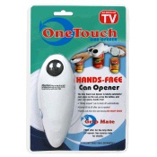
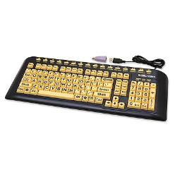
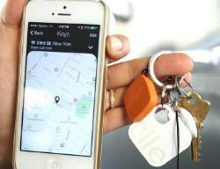
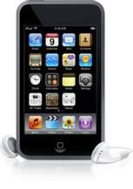
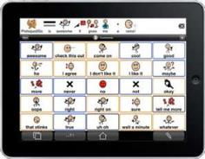
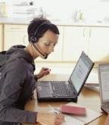
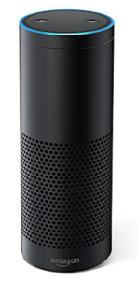
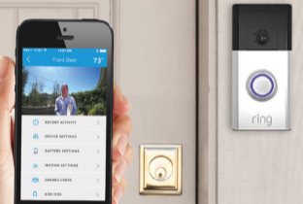
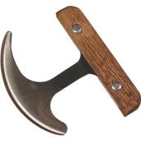
Defining Assistive Technology:

Slide 6
Maude: Mother and Grandmother
Maude is a mother and grandmother living with adult son in a 1-level home
Experiences weakness in her dominant upper extremity from a stroke, and has joint pain from arthritis.
Food preparation tasks are very challenging for her. She has specific health-related nutrition needs.
Maude has difficulty opening cans, slicing vegetables, and organizing the cooking task
What tools may Maude use?

Slide 7
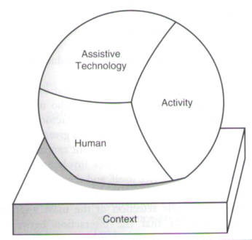
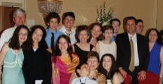
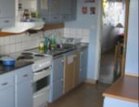
Applying the Human, Activity, and Assistive Technology Model
Assistive technology must match the person, the activity and the context
Cook, A.M. & Polgar, J. M. (2015). Cook & Hussey’s Assistive Technologies: Principles & Practice. 4th edition. St. Louis: Elsevier..
Notes:
The Human Activity Assistive Technology model provides helps us understand that an AT device must meet the needs of the consumer, must work to accomplish necessary tasks, and must be compatible with the contexts and environments in which it will be used.

Slide 8
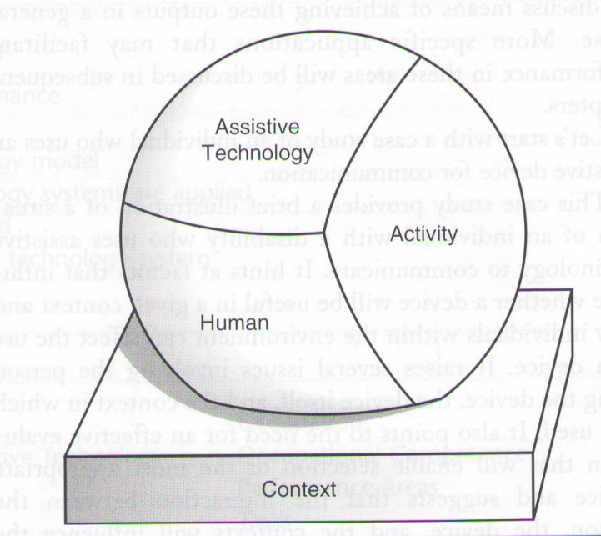
HAAT: Human Factors
Physical factors: Strength, range of motion, coordination, endurance . . .
Cognitive: Memory, organization, problem solving attention to task, divided attention . . .
Sensory: Vision, hearing, touch, sensory processing . . .
Emotional/Psychosocial factors: Frustration tolerance, interest/engagement . . .
Cook, A.M. & Polgar, J. M. (2015). Cook & Hussey’s Assistive Technologies: Principles & Practice. 4th edition. St. Louis: Elsevier..

Slide 9
HAAT: Activity Factors
What activities must the consumer perform?
What are the demands of the task(s)
Self care: Bathing, dressing, food prep, self feeding, coordinating caregivers, maintaining health . . .
Productivity: Work, school, home maintenance
Leisure: Active leisure, sport, social participation . . .
Other?
Cook, A.M. & Polgar, J. M. (2015). Cook & Hussey’s Assistive Technologies: Principles & Practice. 4th edition. St. Louis: Elsevier..

Slide 10
HAAT: Assistive Technology Factors
How does person interact with device?
How does the device operate?
How does the device achieve the goal?
Does the device need to be charged? Plugged in? Updated? Maintained?
Cook, A.M. & Polgar, J. M. (2015). Cook & Hussey’s Assistive Technologies: Principles & Practice. 4th edition. St. Louis: Elsevier..

Slide 11
HAAT: Contextual Factors
Physical context: Space for device?
Institutional: Is there a role for tech?
Cultural
Ethnicity
Environmental culture: School, institution, etc.
Social concerns?
Cook, A.M. & Polgar, J. M. (2015). Cook & Hussey’s Assistive Technologies: Principles & Practice. 4th edition. St. Louis: Elsevier..

Slide 12
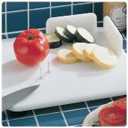
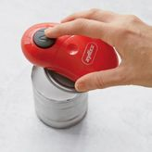
Applying the Human, Activity, and Assistive Technology Model
Assistive technology must match the person, the activity and the context
Cook, A.M. & Polgar, J. M. (2015). Cook & Hussey’s Assistive Technologies: Principles & Practice. 4th edition. St. Louis: Elsevier..
Notes:
Once we’ve considered these factors, we may make suggestions on specific devices that may help Maude meet her Independent Living needs. We can consider adapted cooking utensils like a 1-handed automated can opener, adapted cutting board. We can consider the Amazon Echo for setting timers, and converting cooking measurements.

Slide 13
Review of Programs & Funding Sources
Advanced Training: AT for ADRC Members and Community Partners

Slide 14
MassMATCH AT Programs

Slide 15
Assistive Technology Exchange in New England and New York: getATstuff.org
What: An internet based AT exchange program across New England & New York to Connect with individuals who are selling used AT Devices and DME
Similar to Craigslist - post an item, choose your price, and manage delivery and/or pick up, find an item, negotiate with sellers, etc.
Cost: Free to post and browse, users may sell items
More info, visit www.getATstuff.org

Slide 16
MA Assistive Technology Loan Program
What: Provides low interest consumer loans for AT valued over $500
Cost: Loans repayment lengths based on the expected life of the device:
Computers = 3 years
Speech Communication = 5 years
Hearing and Vision Aids = 5 years
Mobility Aids = 5 years
Modified Vehicles = 8 years
More information, visit www.massatloan.org, or call 1-800-244-2756 ext. 428

Slide 17
Mass AT Long-Term Device Loan Program
What: Provides long-term loan of low-cost AT devices (<$500 in value)
Financial need has to be demonstrated.
Cost: Free
More information, visit www.massatloan.org, or call 1-800-244-2756 ext. 428

Slide 18
REquipment: Durable Medical Equipment (DME) Reuse Program
What: Provides refurbished durable medical equipment such as wheelchairs, scooters, shower chairs and more for adults, children and elders
Items donated are sanitized and refurbished to ensure they’re in good working condition.
Cost: Free, A small delivery charge may apply. For more information, call 1-800-261-9841, write info@dmerequipment.org or visit www.dmerequipment.org
Notes:
Community partners who do some of the actual pick-up, refurbishing and delivery:
UCP Berkshire
Stavros CIL
DDS
Pappas Rehab. Hospital for Children
The Boston Home.

Slide 19
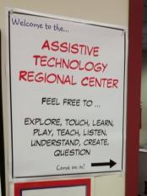
ATRC: Assistive Technology Regional Centers
Device Demonstration & Loan:
What:
Try out AT related to a particular need
Compare devices: learn about the pros and cons to determine best match
Borrow equipment for up to 4 weeks for free!
Multiple locations for pick up and delivery
Cost: Free
Open for all to borrow: Individuals with disabilities, caregivers, professionals, and more.
Notes:
ATRC: Demonstration and Loan Participants in 2016
Individuals with disabilities, 26%
Family members, guardians, and authorized representatives, 30%
Representatives of Education, 13%
Representatives of Employment, 1%
Representatives of Health, allied health, and rehabilitation, 10%
Representatives of Community Living, 4%
Representatives of Technology, 16%

Slide 20
Assistive Technology Regional Centers
Eastern MA
Easter Seals MA
Contact: atrc@eastersealsma.org or call 617-226-2634
Western MA
UCP of Berkshire County, Pittsfield
Contact: atrc@ucpberkshire.org or call 413-442-1562
View inventory at: massmatch.org/inventory
Call or write to schedule an appointment

Slide 21
AT School Share (ATSS)
What: Allows participating schools, school districts & educational collaboratives to share their unused AT
Members can post their AT needs and use ATSS to manage and track their AT inventory
Cost: A FREE for members
For more information, visit www.atschoolshare.org, or call 617-334-5576 or write schoolshare@massmatch.org

Slide 22
Additional AT Programs in Massachusetts
MRC Adaptive Assistance
MRC AT Independent Living Program
MRC Home Modification Loan Program
Massachusetts Commission for the Blind (MCB) AT for the Blind Program
Massachusetts Commission for the Deaf and Hard of Hearing (MCDDH) Communication Access, Training and Technology Services
MA Department of Developmental Services (DDS) Assistive Technology

Slide 23
MRC Adaptive Assistance
Goal: to lead to and/or expand vocational rehabilitation and employment opportunities by eliminating barriers.
For vocational rehabilitation consumers who meet eligibility criteria and have individualized plan for employment
More info: http://www.mass.gov/eohhs/consumer/disability-services/vocational-rehab/rehabilitation-tech.html
Services provided:
Vehicle modification and inspection
Computer & device accessibility
Technical assistance to employers
Mobility devices
Computer hardware adaptations
Worksite modifications
Technology training

Slide 24
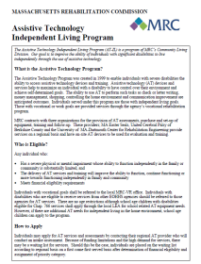
MRC Assistive Technology Independent Living Program
A free program coordinated by MRC’s Independent Living Department
Available to individuals with no comparable AT benefits who meet financial criteria
Provides in-home evaluation, equipment, and setup/training assistance at no cost to the consumer
Goal: Assist individuals with severe disabilities to access assistive technology and training to perform independent living tasks such as:
Communicating with caregivers and healthcare providers
Money management and shopping
Controlling the home environment
Independence in eating

Slide 25
MRC Assistive Technology Independent Living Program
Contract organizations administer program across five regions of MA:
Western MA Area: UCP-Berkshire County 413-442-1562 | dmayo@ucpberkshire.org
Central MA Area, Easter Seals MA 508-751-6431 | ATIL@eastersealsma.org
Greater Boston Area: Easter Seals MA 508-751-6431 | ATIL@eastersealsma.org
Northeast/No. Shore Area: Easter Seals MA 508-751-6431 | ATIL@eastersealsma.org
Southeast/Cape Area: UMass Dartmouth Center for Rehab Engineering 508-999-8482 | bthorn@umassd.edu

Slide 26
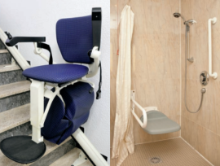
Home Modification Loan Program
0% and low interest loans
Loan amounts from $1,000 to $30,000
Access changes due to functional need
Technical assistance
Home modifications available:
Ramps
Wheelchair lifts/Stairglides
Widened doorways
Roll-in showers
For more information, write sgillam@cedac.org, call 1-866-500-5599, or visit mass.gov/eohhs/consumer/disability-services/housing-disability/home-mod-loan/
Countertop sinks
Lowered cabinets
Door openers
Hardwired alerting systems

Slide 27
MCDHH Communication Access, Training and Technology Services
information resource for the public related to issues of deafness and hearing loss
information and technical assistance to private and public agencies, organizations, businesses and individuals related AT for deaf and hard of hearing individuals
For more information, contact jonathan.o’dell@state.ma.us or visit http://www.mass.gov/eohhs/gov/departments/mcdhh/programs/communicate-train/

Slide 28
MCB AT for the Blind Program
adaptive equipment and consulting to MCB consumers and employers
training on adaptive equipment and software
AT may include: magnification, screen readers and voice technology, JAWS screen reading software, scanners and reading machines, braille embossers and refreshable braille displays, mobile devices and more
For more information, call 617.626.7505, write alexander.pooler@state.ma.us or visit http://www.mass.gov/eohhs/gov/departments/mcb/assistive-tech/assistive-technology-for-the-blind-prog.html

Slide 29
DDS Assistive Technology
Four DDS Assistive Technology Centers statewide: Wrentham, Northampton, Hawthorne & Worcester
Solutions to complicated mobility and other assistive technology needs
Services to DDS consumers who live in facilities and the community
For more information, contact thomas.mercier@state.ma.us or visit http://www.mass.gov/eohhs/gov/departments/dds/assistive-technology.html

Slide 30
The TACLE Instrument
Advanced Training: AT for ADRC Members and Community Partners

Slide 31
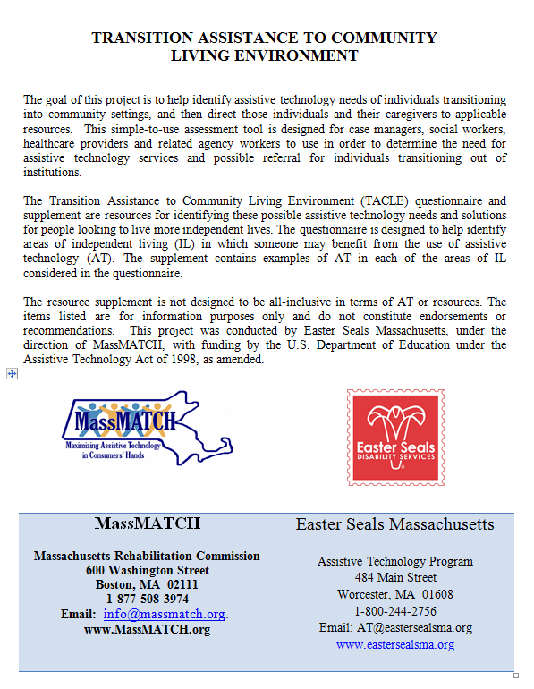
TACLE: Transition Assistance to Community Living Environment
Objective: Identify areas of independent living where a consumer may benefit from AT
organized by areas of independence
not all sections and questions appropriate for every consumer
Developed in 2008 by MassMATCH with Easter Seals MA and Metro West Center for Independent Living
TACLE's goal: lay a foundation for system-wide access to AT where it is needed the most, helping to bring adults with disabilities and elders back to their home communities
MassMATCH. (2008). Transition Assistance to Community Living Environment Questionnaire Instructions. Retreived 6/2/2017 from http://www.massmatch.org/aboutus/publications_videos.php#TACLE_Materials

Slide 32
TACLE: Responses
Yes: consumer can complete the task with complete independence.
No: consumer is fully dependent on another person in order to complete the task, or if the question does not apply.
With Assistance: consumer is able to partially complete the listed task without assistance, may require assistance on occasion, or currently uses some form of AT to complete daily tasks.
Comments: record observations or additional information that may help identify possible assistive technologies at the completion of the interview.
MassMATCH. (2008). Transition Assistance to Community Living Environment Questionnaire Instructions. Retreived 6/2/2017 from http://www.massmatch.org/aboutus/publications_videos.php#TACLE_Materials

Slide 33
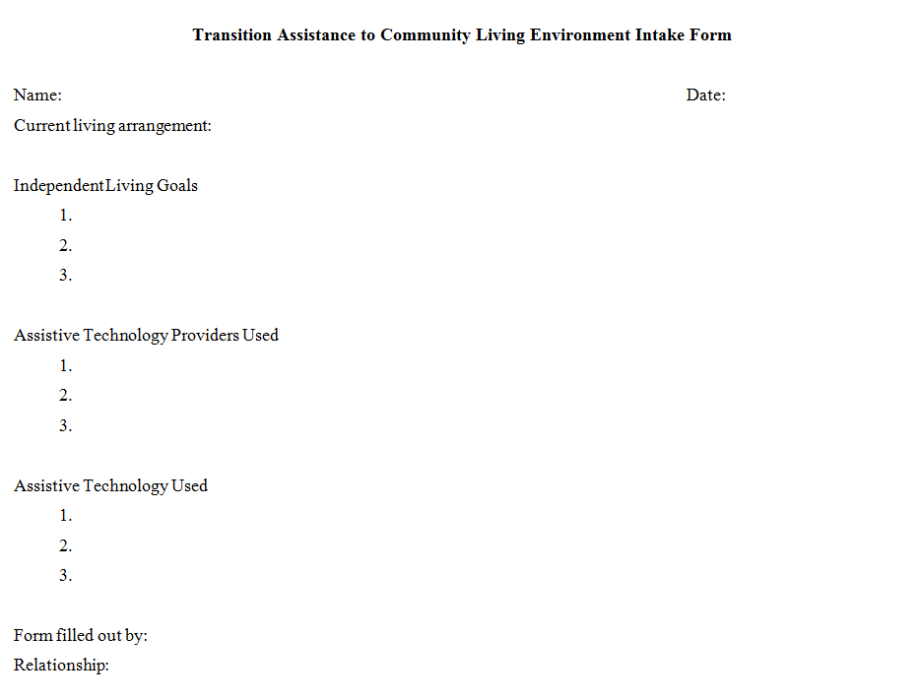
TACLE Intake Form
Gather info about independent living goals, living environment, current AT used, and AT providers used
May be completed over the phone or in person

Slide 34
TACLE Tips
Become familiar with the consumer’s needs and abilities prior to using the tool for best result.
Understand AT, AT providers or AT services the consumer may be using
At the end of each section, ask the consumer if there are concerns in the area of independence that have not been discussed
It may be useful to have the consumer demonstrate some of the skills they are being asked about.
This tool may also be useful as a self-assessment or educational tool.
MassMATCH. (2008). Transition Assistance to Community Living Environment Questionnaire Instructions. Retreived 6/2/2017 from http://www.massmatch.org/aboutus/publications_videos.php#TACLE_Materials

Slide 35
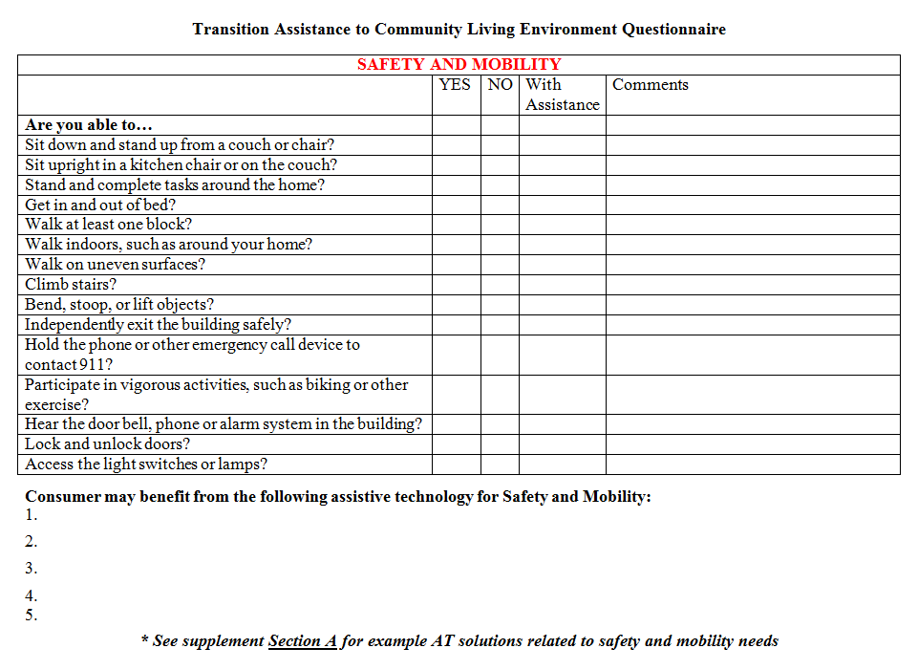
TACLE: Safety and Mobility
MassMATCH. (2008). Transition Assistance to Community Living Environment Questionnaire. Retreived 6/2/2017 from http://www.massmatch.org/aboutus/publications_videos.php#TACLE_Materials

Slide 36
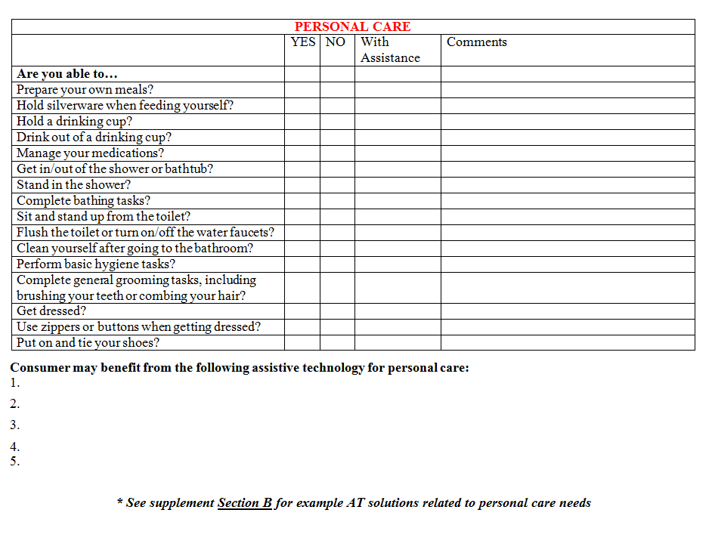
TACLE: Personal Care
MassMATCH. (2008). Transition Assistance to Community Living Environment Questionnaire. Retreived 6/2/2017 from http://www.massmatch.org/aboutus/publications_videos.php#TACLE_Materials

Slide 37
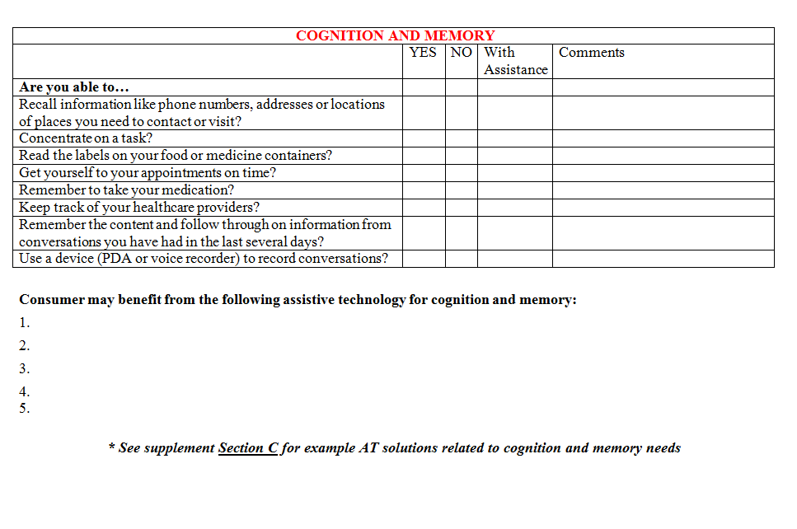
TACLE: Cognition & Memory
MassMATCH. (2008). Transition Assistance to Community Living Environment Questionnaire. Retreived 6/2/2017 from http://www.massmatch.org/aboutus/publications_videos.php#TACLE_Materials

Slide 38
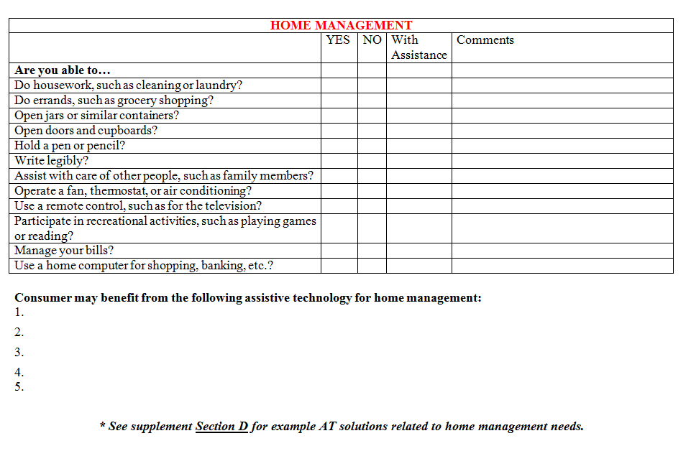
TACLE: Home Management
MassMATCH. (2008). Transition Assistance to Community Living Environment Questionnaire. Retreived 6/2/2017 from http://www.massmatch.org/aboutus/publications_videos.php#TACLE_Materials

Slide 39
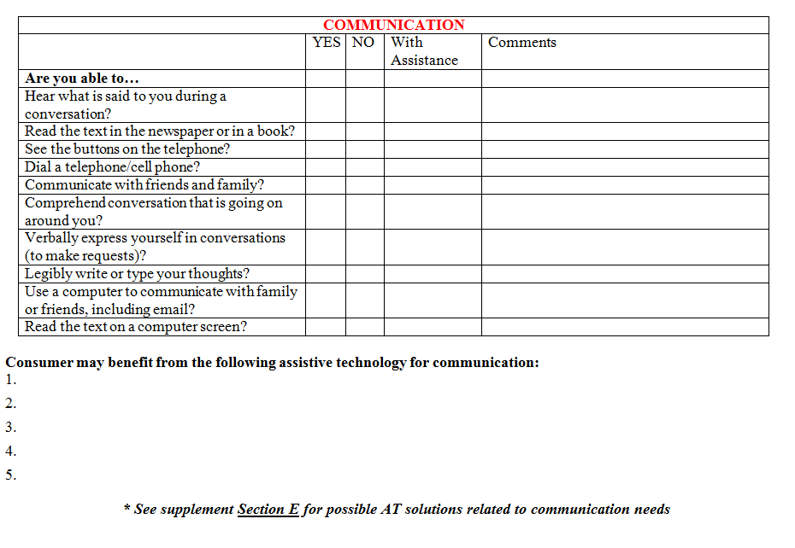
TACLE: Communication
MassMATCH. (2008). Transition Assistance to Community Living Environment Questionnaire. Retreived 6/2/2017 from http://www.massmatch.org/aboutus/publications_videos.php#TACLE_Materials

Slide 40
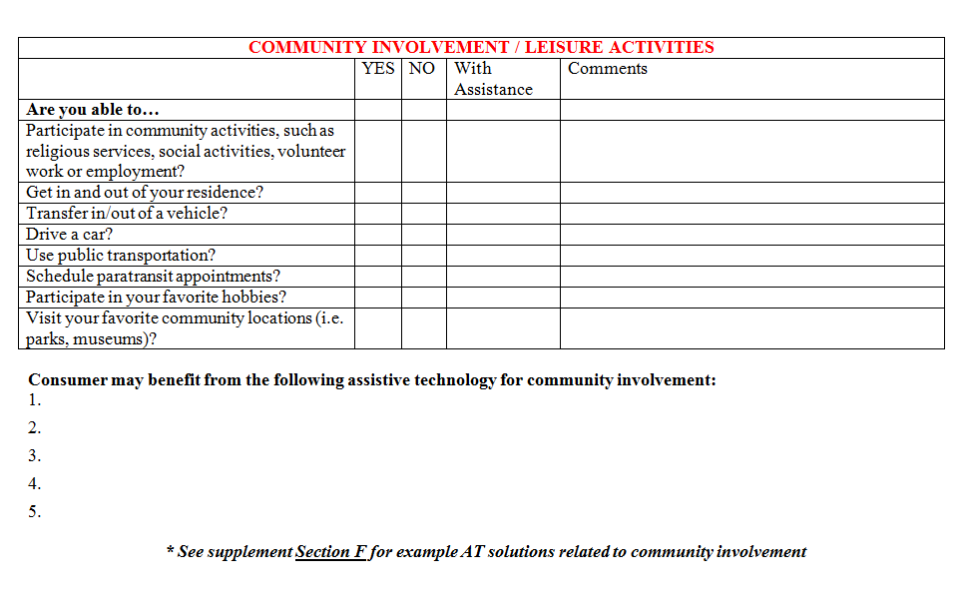
TACLE: Community Involvement/Leisure
MassMATCH. (2008). Transition Assistance to Community Living Environment Questionnaire. Retreived 6/2/2017 from http://www.massmatch.org/aboutus/publications_videos.php#TACLE_Materials

Slide 41
Using the TACLE Tool
Advanced Training: AT for ADRC Members and Community Partners

Slide 42
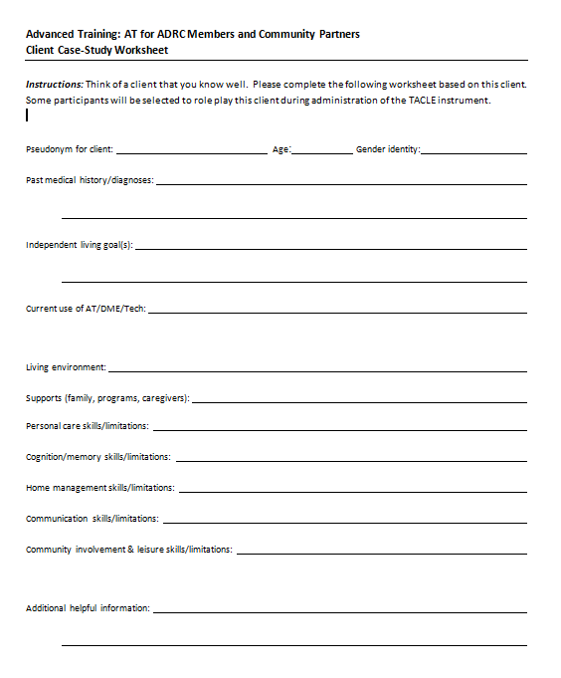
Activity: Considering the consumer
Please complete the Client Case Study Worksheet
We will use this worksheet to complete the TACLE Instrument in small groups after lunch

Slide 43
Activity: Completing the TACLE
In your group of 3-4 participants, please collaborate with a group member to use the TACLE tool with another group member role playing their consumer
We will have an opportunity to share and discuss results.
Refer to the TACLE Supplement for specific suggestions for Assistive Technology considerations, or consider a device from your own experience

Slide 44
For More Information
Visit: massmatch.org
Call: 877-508-3974
Write: info@massmatch.org
Thank you for joining us today!

